Slide 1
Module 2 procurement management fundamentals
Mgmt 6063 – Project Procurement

Slide 2
Module agenda
Module Learning Outcomes
Use of generic procurement processes and terminology
Understand responsibility and focus of the procurement department/group
Understand procurement pitfalls and success factors
Homework/evaluations
Notes:
Image https://www.sandler.com

Slide 3
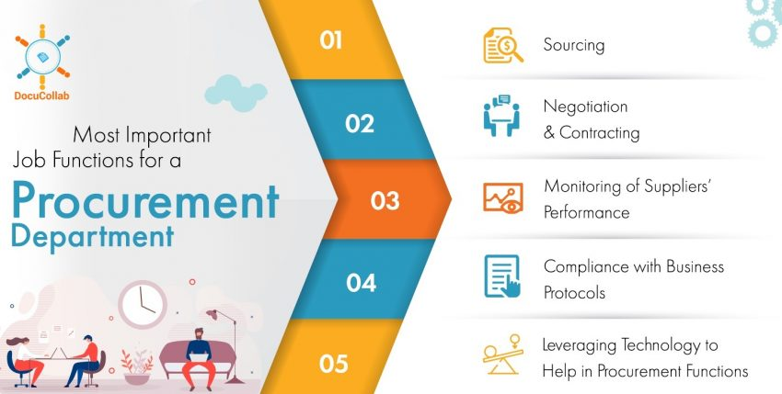
The procurement industry
An Indeed.com search done on November 4, 2021, using the key word “procurement” and the geography “Canada” yielded 2,469 jobs!
Data from 2020 shows 65,000 thousand buyers and procurement officers in the UK
Procurement can be a critical part of an organization’s strategy
FYI Only
Notes:
Sourced from https://www.statista.com/statistics/319809/number-of-buyers-and-procurement-officers-in-the-uk/
Image https://docucollab.com/

Slide 4
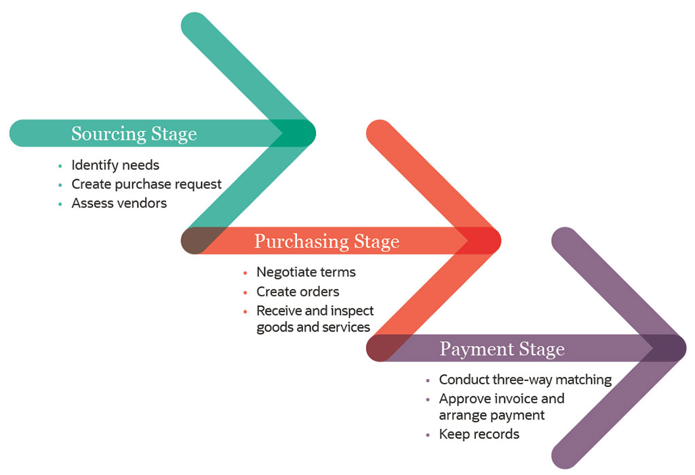
generic procurement process
Notes:
Image and some content from: https://www.netsuite.com/portal/resource/articles/accounting/procurement.shtml

Slide 5
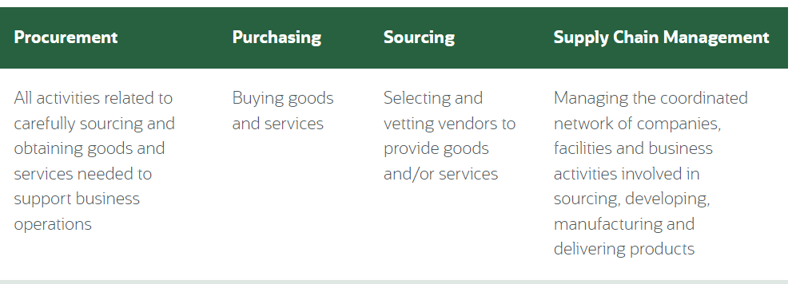


generic procurement terminology
What is Procurement?
(2:09min).
Click here.
Notes:
Image and some content from: https://www.netsuite.com/portal/resource/articles/accounting/procurement.shtml
Image https://www.biospectrumindia.com/features/69/8696/procurement-managers-critical-link-in-supply-chain-pharmaceutical-management.html

Slide 6

Government procurement
Consider all the purchases made on behalf of Canadian residents by Public Services and Procurement Canada
Importance of transparency and standardization
Government Procurement (2:43min).
Click here and scroll down to video.
Notes:
Photo engineerscanada.ca

Slide 7

Generic Procurement processes
Identifying company needs
Forecasting demand
Planning purchases
Market research
Identifying and evaluating potential suppliers
Supplier selection
Supplier relationship management
Defining criteria
Negotiation
Purchases
Let’s work through an example. You’re responsible for (non-project) procurement of new desks and chairs for 50 people in your office What activities will be carried out during:
Sourcing?
Purchasing?
Notes:
Sourced from https://www.thomasnet.com/articles/other/what-is-procurement/
Image wayfair.ca

Slide 8
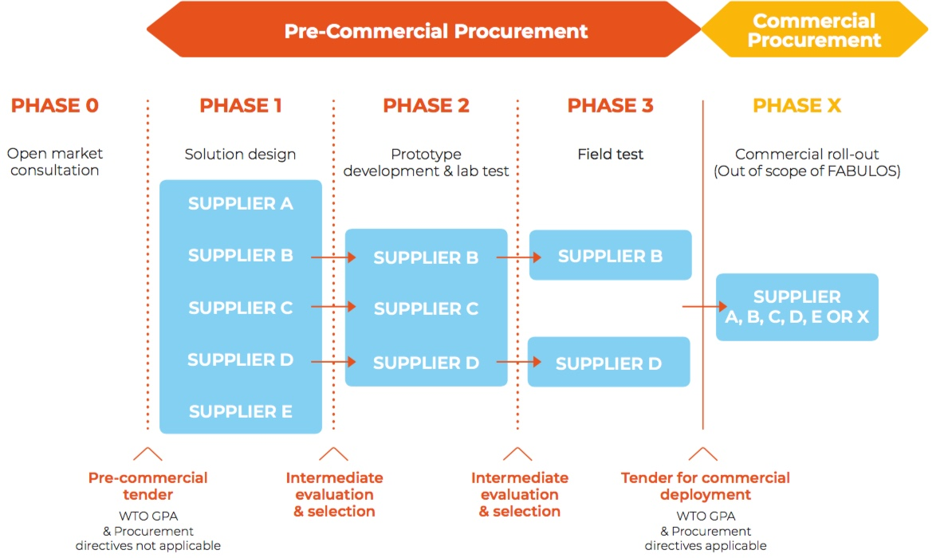
Phased procurement
https://fabulos.eu/fabulos-precommercial-procurement/
See Slide Notes
Note Supplier’s A and D participated in Phase 1 to 3 pre-commercial procurement but the commercial procurement is open to all suppliers.
Notes:
Source https://fabulos.eu/fabulos-precommercial-procurement/
“The FABULOS project seeks new solutions and technologies to prepare cities for the future of mobility, including concepts such as self-driving buses. Novel transport solutions will be developed and acquired by utilising a Pre-Commercial Procurement (PCP), which allows the Procuring Partners to share the risks and benefits with the suppliers. The expected outcome of the FABULOS project is the demonstration of automated minibus service as part of the public transport system.”
See also https://fabulos.eu/

Slide 9
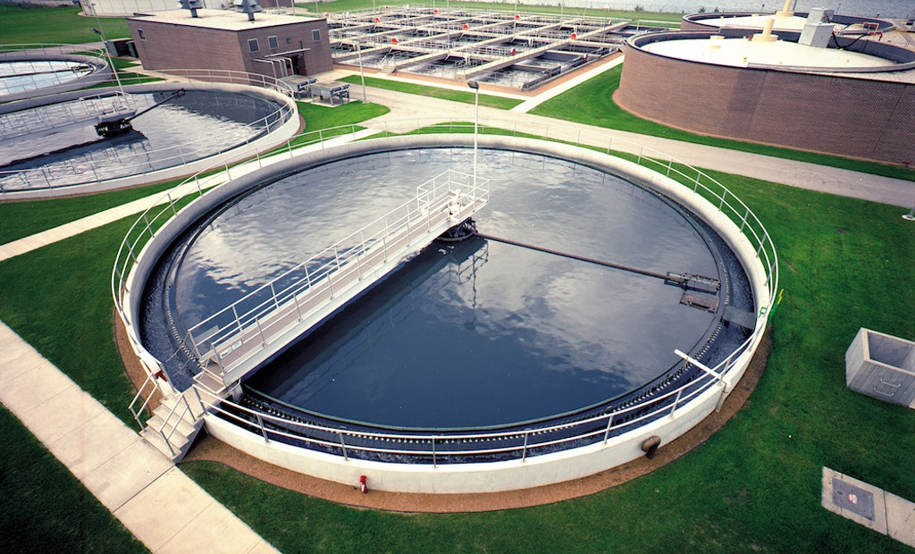




Phased procurement
The City of London needs additional wastewater (sewage) treatment capacity.
Possible procurement phases where each could be with a different service provider (e.g., consultant, contractor, operator):
Environmental Assessment including public consultation and preliminary design
Detailed design
Construction
Operations of completed facility
Notes:
image tpomag.com

Slide 10
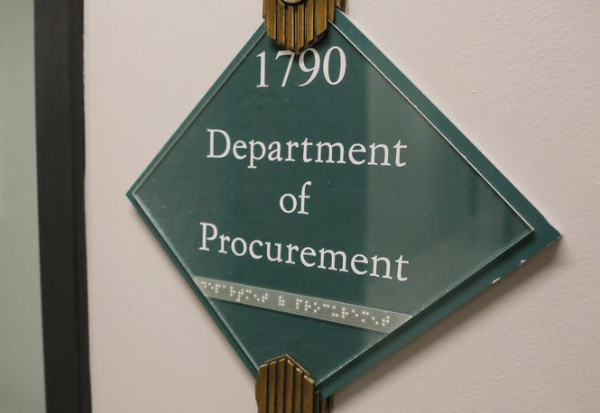
Objectives of the procurement department/group
Supporting the organization’s strategy (example: centralized procurement)
Primary function of the purchasing department: lower costs.
Security of supply
Supplier reliability
Risk reduction and mitigation
Quality improvement
Sometimes reducing the number of suppliers, sometimes diversifying suppliers
Achieving KPI targets such as savings on supplier spend
Notes:
Image https://www.ajc.com/news/local-govt--politics/atlanta-axes-top-purchasing-officer-feds-seize-items-from-his-office/UpGpKTqrgHFvMNLFPpx1MP/

Slide 11


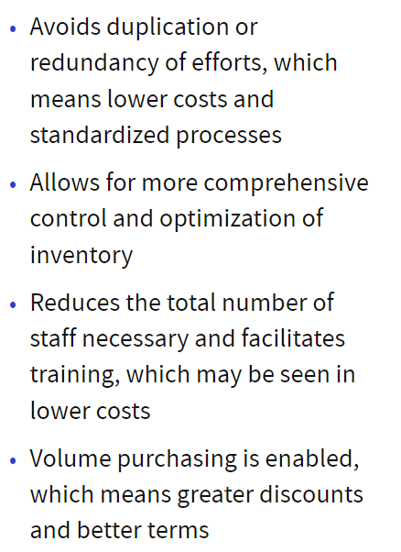
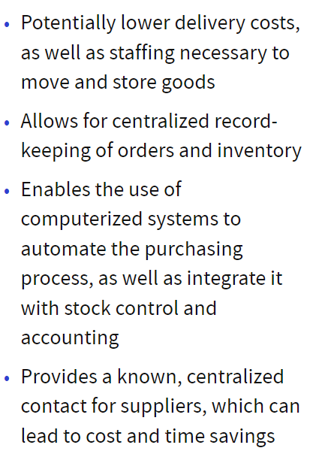
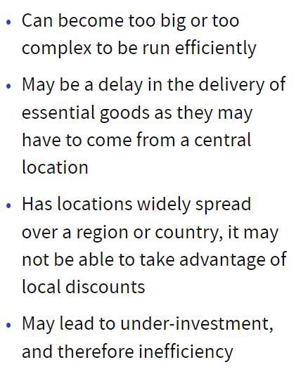
Centralized procurement
Notes:
https://www.investopedia.com/terms/c/central-purchasing.asp

Slide 12
Project managers and the procurement department
There is tremendous value in a good working relationship with your organization’s procurement department, even the basics can be complex
Project Procurement Basics
(2:14min).
Click here.

Slide 13

Procurement pitfalls
Conflict of Interest
Competing professional and personal interests
Serving one interest threatens the other
Manage perception/reality
Recognize possible biases and disclose them
Consider removing yourself
Involve others in decision making
We’ll address in more detail in a future module
You may recall Conflict of Interest issues from other project management courses you may have taken such as MGMT 6054
Notes:
Image from https://www.dcresponse.co.uk/8-pitfalls-avoid-purchasing-ups/

Slide 14
Procurement pitfalls
Failure to Communicate Objectives
Potential vendors are not mind readers
Describe your environment
“big picture”
Your goals – “must haves” and “nice to haves”
Be as specific and detailed as you can be
Notes:
Image from https://www.dcresponse.co.uk/8-pitfalls-avoid-purchasing-ups/

Slide 15
Procurement pitfalls
Other procurement risks
https://quandarycg.com/procurement-risks-and-how-to-navigate-them/
Notes:
Image from https://www.dcresponse.co.uk/8-pitfalls-avoid-purchasing-ups/

Slide 16

Procurement success factors
Stay current – best practices, lessons learned
Start procurement early in the project life cycle
Communicate regularly with your procurement team – honestly and openly
Include change management/conflict resolution into the contract
Ensure work is completed as contracted before “signing off” on the contract
Notes:
Image from https://clipartix.com/success-clipart-image-60586/

Slide 17
Matching game
Handout or Word doc
Terminology matching game from Modules 1 and 2
See Word doc on FOL called
M1&M2 Terminology Match Up.docx

Slide 18
Summary of our journey today
The generic procurement processes and terminology
Phased procurement
Responsibility and focus of the procurement department/group
Procurement pitfalls and success factors

Slide 19
Homework and evaluations
Readings for next module as listed in Course Overview.
Individual Assignment – Procurement in YOUR Life

Slide 20
references
Project Management Institute (2017). A Guide to the Project Management Body of Knowledge (Sixth Edition).
Kerzner, Harold (2017). Project Management, Twelfth Edition.
Watts, A. (2014). Project Management. Victoria, B.C.:BCcampus. Retrieved from https://opentextbc.ca/projectmanagement/.

